Slide 1
STOCHASTIC PROCESSES
LECTURE-2 CC: Ms. Shiza Riaz Memon

Slide 2
Markov Chain
A random Process in which occurrence of future state depends on the immediately preceding state and only on it, is known as Markov Chain.
A Markov process is a time-based process where the probability of a state on the next trial (time period) depends only on the state in the current trial (time period) and not on how one got to the present state.
Uses of Markov Chains: 1. Behavior of consumers in terms of their brand loyalty and switching pattern.
2 Machine use to manufacture a product. The machine will have two states working or not working at any point.

Slide 3
System and State
System: The environment or context
In first use of Markov Chain, the system is the market place and machine in the second example.
State: A state is a condition or location of an object in the system at a particular time.
In first example, the brand becomes the state as the customer switches different brands and the on-off status is the state of the machine at a particular time.

Slide 4
Assumption of Markov Chain
Finite number of states.
States are mutually exclusive; The events does not have anything in common. Disjoint sets. P AՈB=0
State are collectively exhaustive
If there are two events A & B then AUB=Sample Space
In collectively exhaustive event the P(AorB)=1
Probability of moving from one state to another remains constant.

Slide 5
Transition Probability
The probability of moving from one single to another state or remaining in the same state during a single time period is called the transition Probability.
The time period would remain discrete.
Mathematically, Pij= P (next state Sj at t=1/ initial state Si at t=0)
i=initial state
J=next state

Slide 6
Transition Probability Matrix
With the help of transition Probability matrix (TPM), one can predict the movement of system from one state to the next state.
S1 S2 S3
S1 [ P11 P12 P13 ] initial state I (n=0)
S2 [ P21 P22 P23] next state j (n=1)
S3 [ P31 P32 P33]
P 11 = P [in state S1 in next state at t=1/ in state S1 in initial state at t=0]
P12= P[ S2 at time t=1/S1 at time t=0]
P21=P[S1 at time t=1/S2 at time t=0]
These transactions are called one step transactions

Slide 7
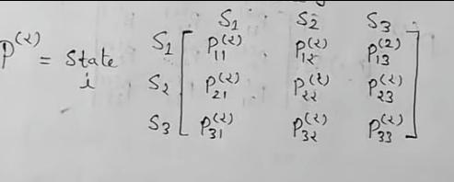
N- step transition probability
P11² = P [in state S1 in next state at t=2/ in state S1 in initial state at t=0]
The entire matrix becomes a square of all probabilities
This is called 2- step transition probability

Slide 8
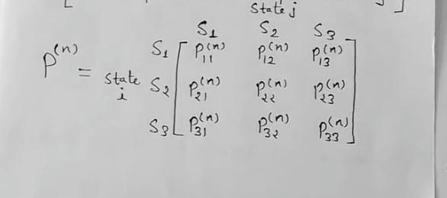
N-step transition probability
P11^{n} = P [in state S1 in next state at t=n/ in state S1 in initial state at t=0]
We are transitioning from one state to another in n time

Slide 9
Transition Probability Matrix
Some assumptions of TPM:
Row sum=1. Row shows the transition from current state to the next state and we move to other states with some probability. So the sum of all probabilities should be equal to 1.
Each element of TPM is a probability. Which means that 0<= Pij<=1 and non negative.
TPM will always be square matrix because
Row will show initial states.
Column will show alternate states or next state
If you move row wise you will be under retention and loss.
If you move column wise, you will be under retention and gain
Diagonal movement is only retention

Slide 10
Example 1:
In a certain market , only two brands of cold drinks A and B are sold. Given that a man last purchased brand A, there is 80% chance that he would purchase the same brand in the next purchase, while if a man purchased brand B , there is 90% chance that his next purchase would be brand B. Using this information: a) Develop transition probability matrix b)Interpret the state transition matrix in terms of i)Retention & loss ii)Retention & gain c) Draw Transition Diagram.

Slide 11
Solution a)
Next purchase (n=1)
A B
P= Present purchase (n=0) A [0.8 0.2] =1
B [0.1 0.9] =1

Slide 12
Solution b)
Row wise retention & loss
P11 or Paa = P (A next time at t=1/ at initial state A at t=0) P11 = 0.8 or 80% = retention to A
P12 or Pab= P (B next time at t=1/ at initial state A at t=0)
P12= 0.2 or 20 % = loss to A
Column wise Retention & Gain P21 or Pba = P (A next time at t=1/ at initial state B at t=0)
P21= 0.1 or 10% = loss to B
P22 or Pbb= P (B next time at t=1/ at initial state B at t=0)
P22 = 0.9 or 90 % = retention to B

Slide 13
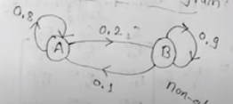
Solution c)
Transition Diagram
Absorbing state= A to B Transition and B to A transition movement is possible

Slide 14
Example 2:
Q) The school of International studies for population found out by its survey that the mobility of a population of a state to the village, town and city is in the following percentages: Village Town City
From Village 50% 30% 20% Town 10% 70% 20% City 10% 40% 50%
A) Interpret the state transition matrix in terms of i) Retention & Loss ii) Retention & gain
B) Draw transition diagram

Slide 15
Solution
P11= 0.5=Retention to Village
P12=0.3= Loss to village
P13=0.2= Loss to village
P21=0.1= Loss to town and gain to village
P22= 0.7= Retention to town
P23= 0.2= Loss to town
P31= 0.1= Gain to village

Slide 16
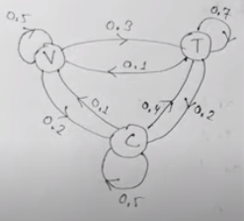
Solution
B) Transition Diagram

Slide 17
Classification of States
The following transition matrix illustrates most of the following definitions:
0.4 0.6 0 0 0
0.5 0.5 0 0 0
0 0 0.3 0.7 0
0 0 0.5 0.4 1
0 0 0 0.8 0.2

Slide 18
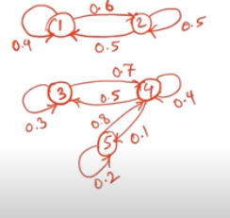
Transition Diagram

Slide 19
Definitions
Given two states i and j, a path from i to j is a sequence of transitions that begins in i and ends in j, such that each transition in the sequence has a positive probability of occurring.
Such that transition from state 3 to state 5
A state j is reachable from the state i if there is a path leading from i to j.
Two states I and j are said to communicate if j is reachable from i and i is reachable from j.
A set of states S in a Markov Chain is a closed set if no state outside of S is reachable from any state in S
Such that state 1 & 2 {1,2} are closet set of states, similarly state 3,4 & 5 {3,4,5} are closed set of states.

Slide 20
Definitions
A state i is and absorbing state if P_{ii}=1
A state i is a transient state if there exists a state j that is reachable from i, but the state i is not reachable from state j.
Alternatively, a state i is a transient state if there exists a way to leave state i and never return to state i again.
If a state is not transient, it is called a recurrent state.
A state i is periodic with period k>1 if k is the smallest number such that all paths leading from state i back to state i have a length that is a multiple of k. If a recurrent state is not periodic, it is referred to as aperiodic.

Slide 21

Absorbing states
A gambling problem example:
P₀₀=1 and P₄₄=1 so these are absorbing states.

Slide 22

Transient States
A state i is a transient state if there exists a state j that is reachable from i, but the state i is not reachable from state j.
Alternatively, a state i is a transient state if there exists a way to leave state i and never return to state i again.
State {1,2,3} are transient states.

Slide 23
Recurrent states
A gambling problem example:
P₀₀=1 and P₄₄=1 so these are recurrent states.
Absorbing states are naturally recurrent because once we get there then we stay there infinitely
However, all recurrent states are not absorbing.

Slide 24
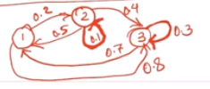
Recurrent states
If the states have atleast one path of coming back to it again the that is recurrent state.
In the below example, the states have self transition with probabilities less than 1.
Only those states with self transition probability equals to 1 are absorbing.
Rest all others are recurrent

Slide 25

Periodic States
A state i is periodic with period k>1 if k is the smallest number such that all paths leading from state i back to state i have a length that is a multiple of k.
For example, for state 1 the shortest path that can take me out of 1 and bring me back is L=2,
And the other path would be L=4 (multiple of 2)
L=K>1; thus self transition does not apply here as a length of transition
Thus state 1 is periodic state.

Slide 26
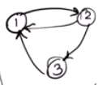
Aperiodic States
Here state 1 is aperiodic because the length of shortest path L=2.
However, we have found another path that takes us out of 1 and bring us back to 1. that is from 1 to 2, 2 to 3 and 3 to 1.
Thus for this transition L=3.
However it is not multiplication of 2 so it is not periodic.
Whenever you see a self transition, you must know that that state is aperiodic because K must be >1 the length of shortest path must be greater.

Slide 27
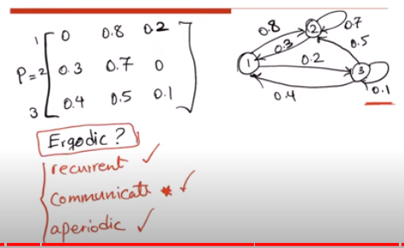
Ergodic Chain
If all states in a chain are aperiodic, recurrent and communicate with each other the chain is said to ergodic.
Whether following chain is ergodic ?

